Slide 1

NYC Shooting Project
Rachel weber

Slide 2
Quick Recall
Data:
NYC Shooting Incidences from 2006 through 2018
Questions:
What are the odds of the shooting-free weekend that occurred in October 2018
Given historic data, can we forecast future counts of shootings per month
Predict number of shootings on a given day
Variables:
Year
Season
Day of the week
Pre/Post SAFE Act implementation in January 2013

Slide 3
Aims and Hypotheses
Aims:
Use probability theory to calculate the odds of a shooting-free weekend given historical data
Build model to predict number of shootings per month for next 3 years
Build model to predict number of shootings on a given day
Hypotheses:
The shooting-free weekend was expected given a large number of observable weekends in NYC
Given historic trends, number of shootings per month will continue to decrease
Day of the week is a significant predictor of the number of shootings that occur in a day

Slide 4
Data analysis plan
All data was verified before upload by NYC, therefore data quality/accuracy checks aren’t needed. There is no missingness in the date and time variables, so I do not need to address missing data before analysis.
Aim 1:
Do manual probability calculations to determine the odds of a consecutive Friday, Saturday, and Sunday having zero shootings
use conditional probability calculations to calculate the probabilities for Saturday and Sunday
Aim 2:
Negative Binomial model to predict the number of shootings on a given day
Aim 3:
Timeseries model forecasting future number of shootings per month for the next 3 years

Slide 5
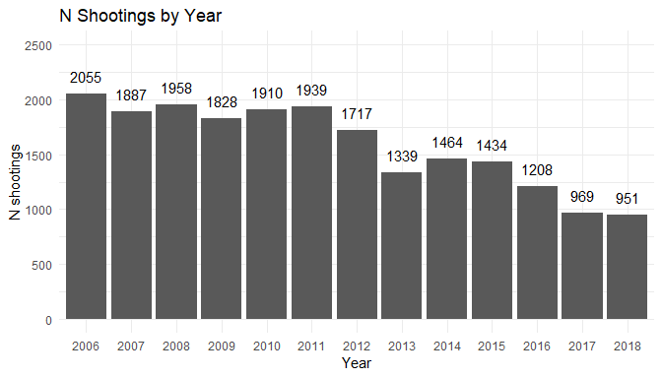
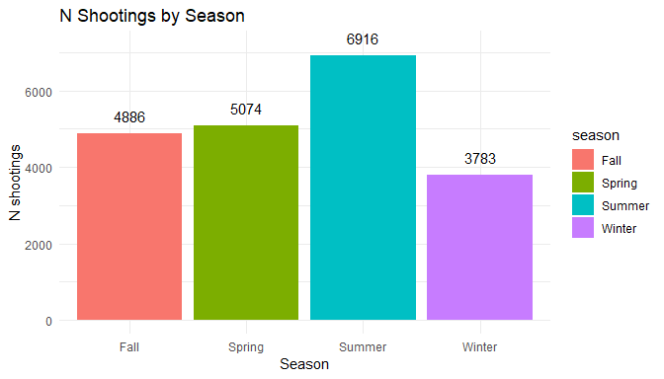
Figures

Slide 6
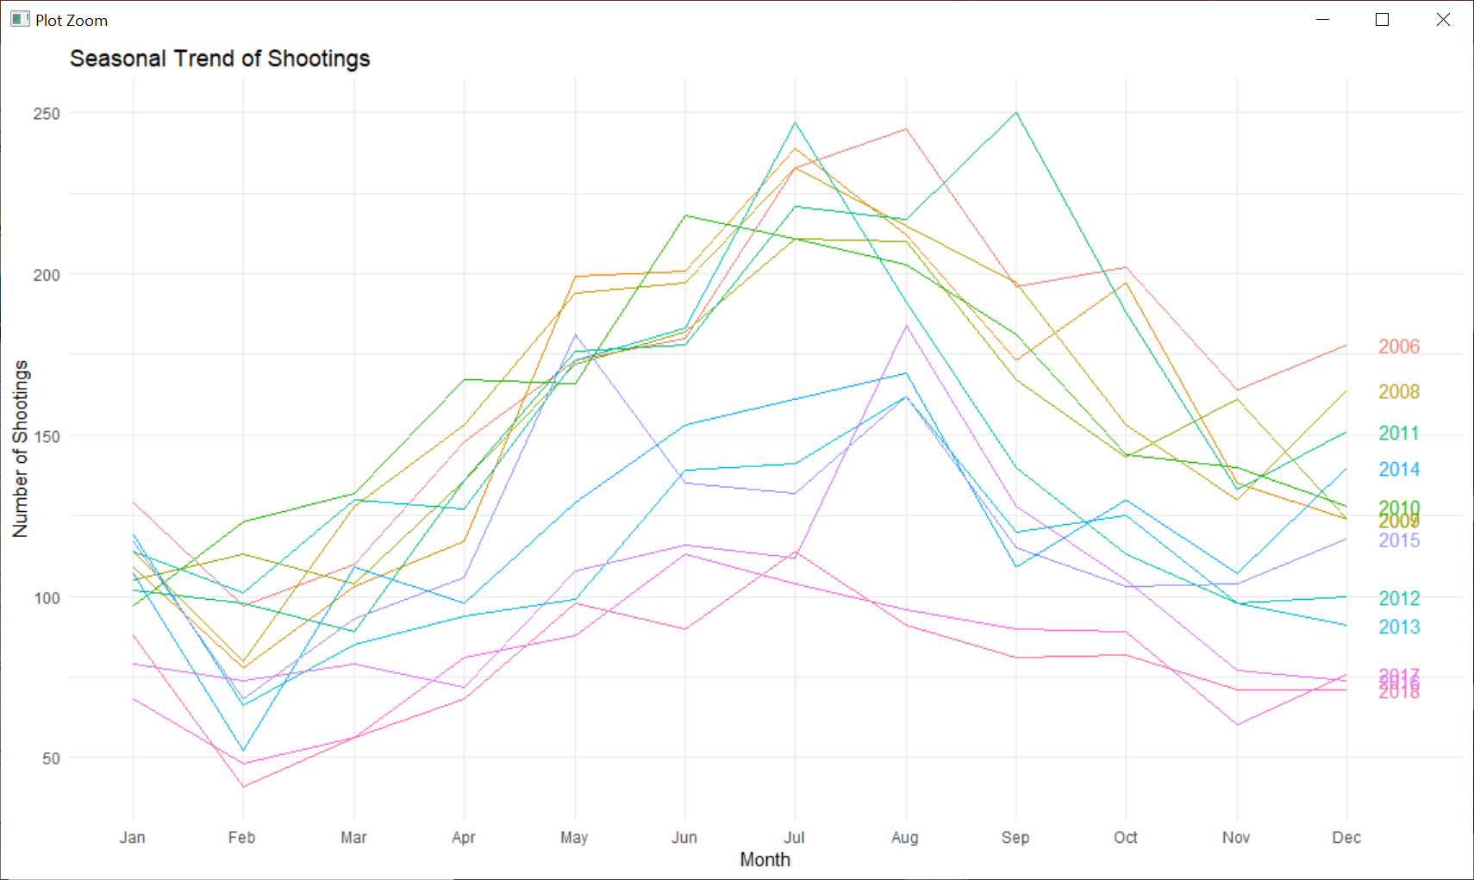
Figures

Slide 7
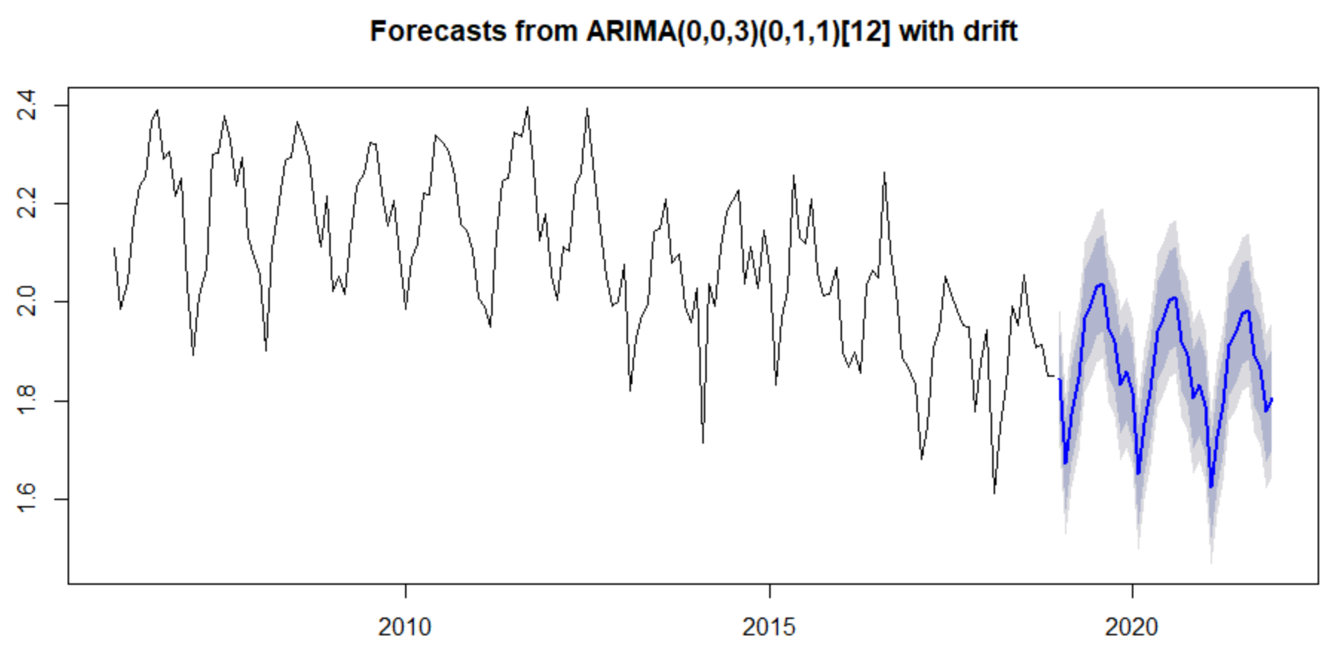
Figures

Slide 8
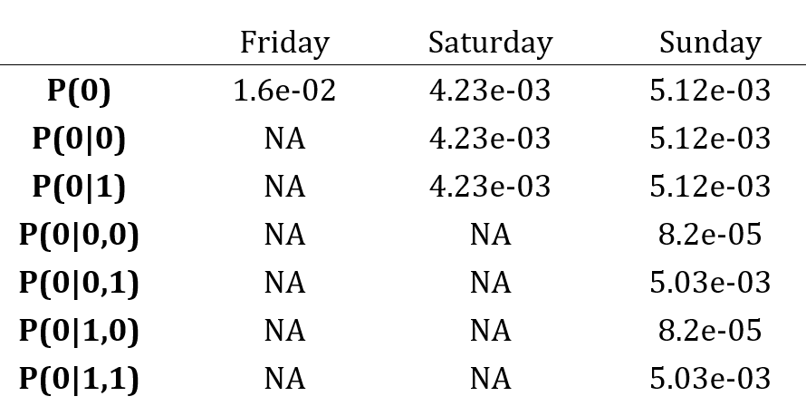
Tables
For manual probability calculations:
For negative binomial model:
Variable | Estimate | SE | P-value
Year
Monday
Tuesday
…
Sunday
Pre/Post SAFE Act
Season
Not sure how to present ARIMA models yet.

